Slide 1
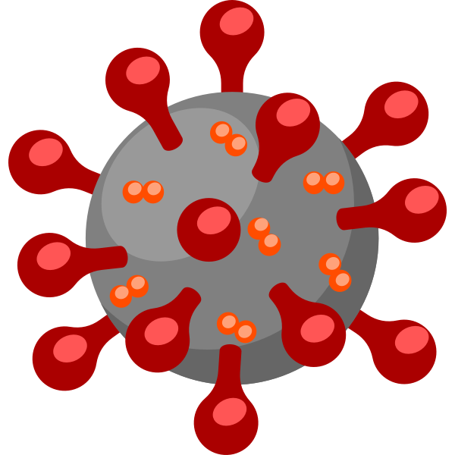
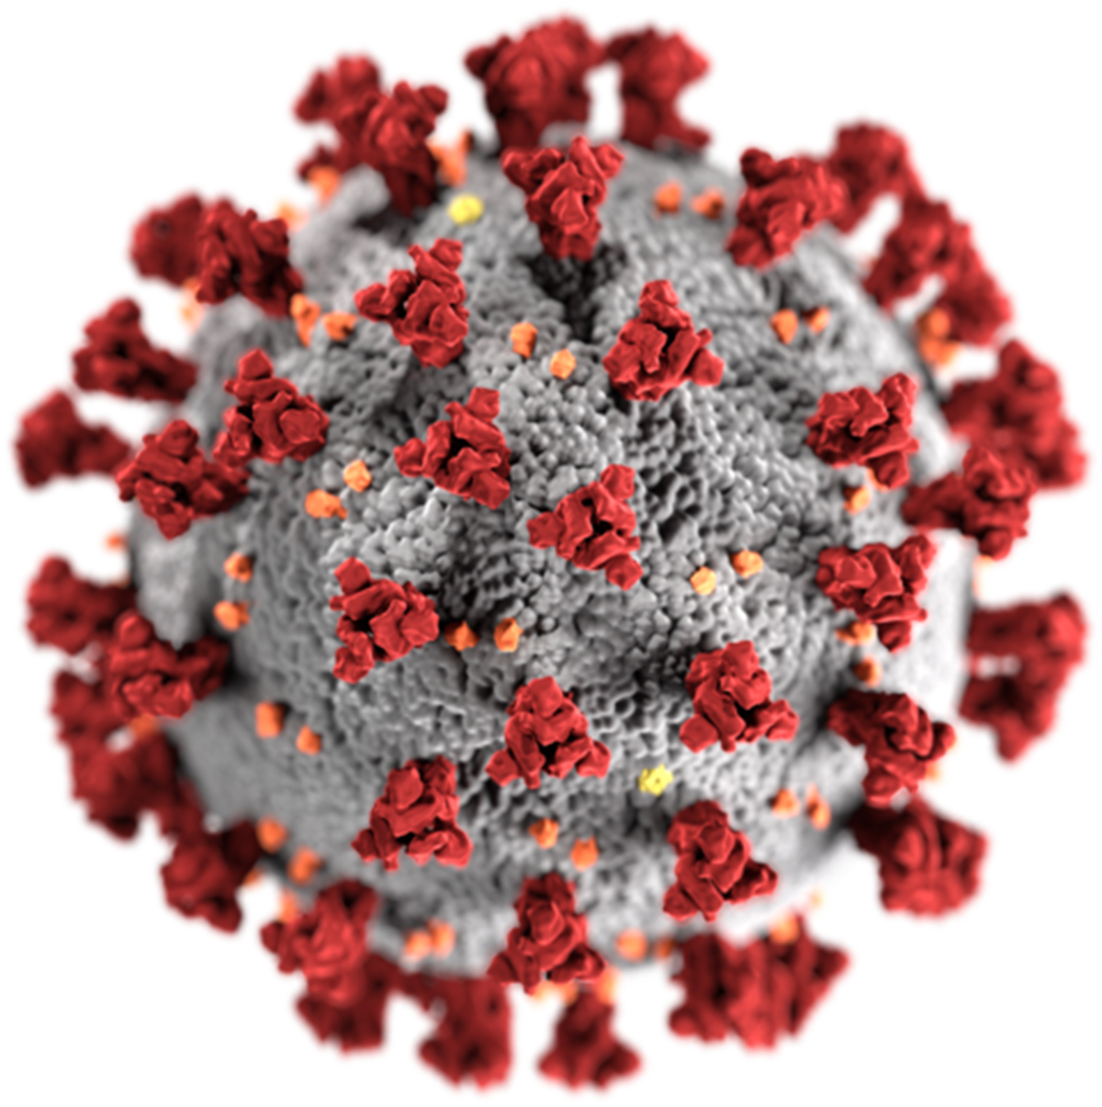
COVID-19 Data Dashboard & Trend Analysis
Visualizing Pandemic Trends and Metrics
PRESENTETATION BY : SHRUTI BADAGANDI
1

Slide 2
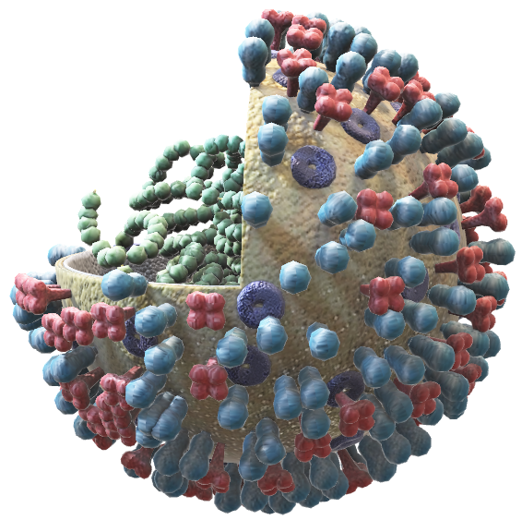
INTRODUCTION
The COVID-19 pandemic has been one of the most significant global health crises in modern history, profoundly affecting millions of lives and economies worldwide. COVID-19 is a disease caused by the coronavirus called SARS-CoV-2. It's a respiratory illness, which means it mainly affects the lungs and breathing. It became a global pandemic starting in early 2020.
In 2025, many countries are again reporting a rise in COVID-19 cases, especially during seasonal changes (like winter or monsoon) when people gather indoors and viruses spread more easily.
data has played a critical role in understanding the spread of the virus, evaluating health system responses, and guiding public policies.
This project focuses on the analysis and visualization of global COVID-19 data using statistical tools and dashboards. By integrating various pandemic-related metrics — such as confirmed cases, deaths, recoveries, vaccinations, and testing rates — the aim is to provide a clear and interactive way to explore how the pandemic has unfolded over time and across countries.
2

Slide 3

Tools & Libraries
PYTHON : Data Cleaning, Visualization, Modeling
LIBRARIES :
PANADS – For Manipulation
MATPLOTLIB & SEABORN – For Plotting Trends and Charts
Machine Learning (Linear Regression )
POWER BI : For Building Dynamic, Filterable Dashboard
DATA SOURCE : COVID-19 Dataset.csv
PLATFORM : VS CODE
3

Slide 4
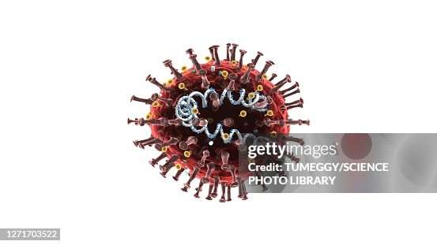
DATASET OVERVIEW
The COVID-19 dataset utilized in this project is a structured, time-series collection of global pandemic statistics compiled from credible public health sources. It encompasses data from over 190 countries/regions, covering a wide spectrum of pandemic indicators from early 2020 onwards.. The dataset forms the foundation for all visualizations, dashboards, and predictive models in this project.
Each row represents a specific country and date, enabling time-series analysis.
Preprocessing was done using Python (Pandas) for cleaning, date conversion, missing value handling, and type casting.
The data supports insights into trends, forecasting, vaccination rollout, and comparative health outcomes

Slide 5
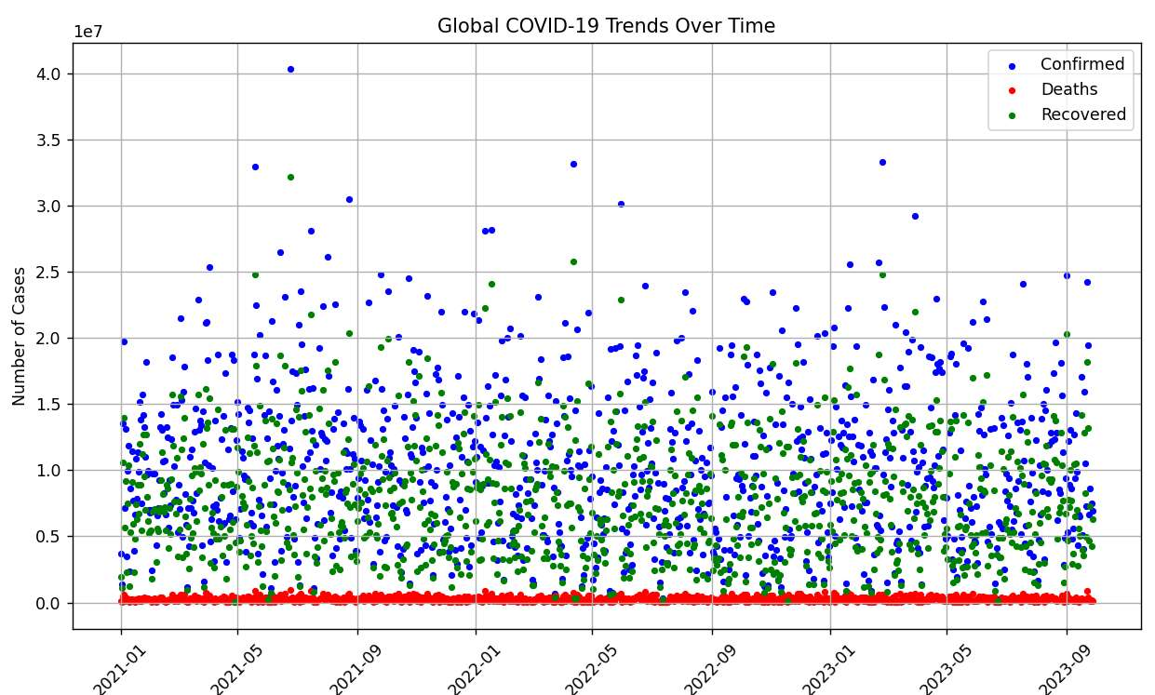
Trend Analysis – Confirmed, Deaths, Recovered
Confirmed Cases: The number of confirmed cases surged sharply in early 2020 as the virus spread worldwide. The steep rise during global waves (notably the Delta and Omicron variants) showed how rapidly the virus could transmit.
Recovered Cases: Recovery rates improved substantially over time, especially from mid-2020 onward. As more patients received early diagnosis and access to improved medical care, This trend reflects healthcare systems adapting, along with increased immunity (both natural and vaccine-induced)
Death Cases: The trend of deaths lagged behind that of confirmed cases due to the time it takes for severe symptoms to develop post-infection. Peaks aligned with major waves but declined over time to improved treatment, early detection & vaccination.
5

Slide 6

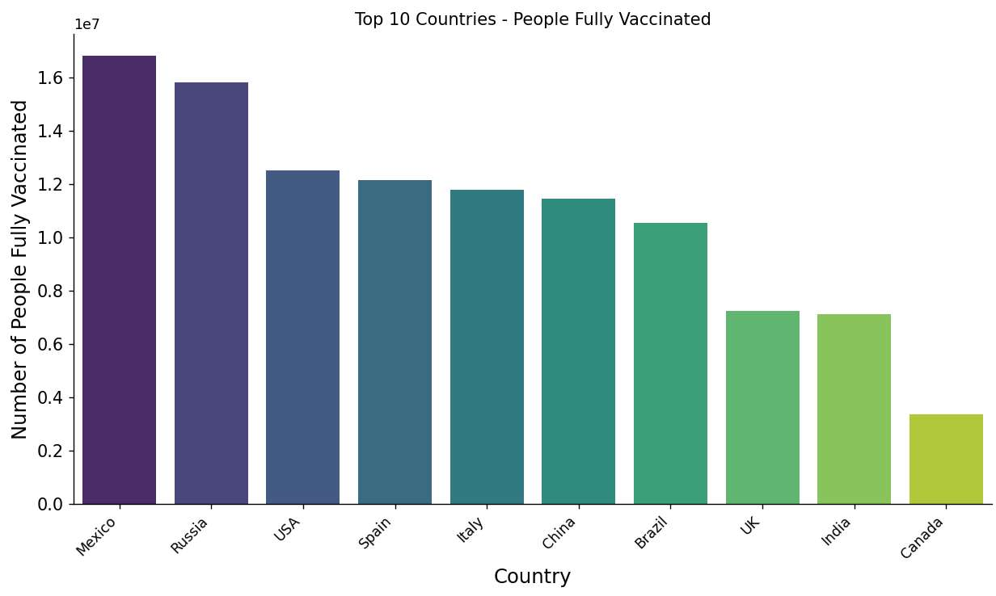
VACCINATION PROGRESS BY COUNTRY
The chart illustrates the top 10 countries with the highest number of fully vaccinated individuals against COVID-19, based on the latest available global data.
This comparison highlights how various countries have progressed in their mass immunization efforts, which played a vital role in controlling the pandemic.
6
This Photo by Unknown Author is licensed under CC BY-SA

Slide 7
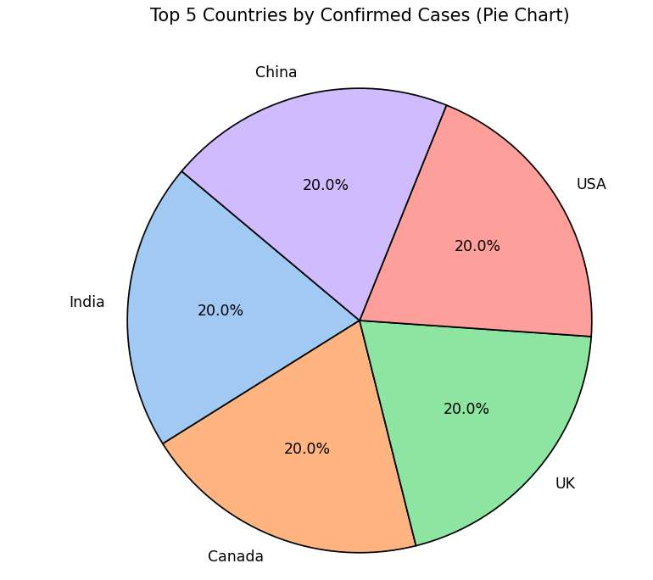
COMFIRMED CASES BY COUNTRIES
The pie chart displays the Top 5 countries with the highest number of confirmed COVID-19 cases, based on the maximum recorded cases from the dataset. This view gives a snapshot of how the pandemic disproportionately impacted certain regions.
The United States leads with the highest number of confirmed cases, followed by India and other highly populated or hard-hit nations.
These countries experienced multiple waves of infections, influenced by factors such as population density, testing capacity, mobility, and variant spread
7

Slide 8
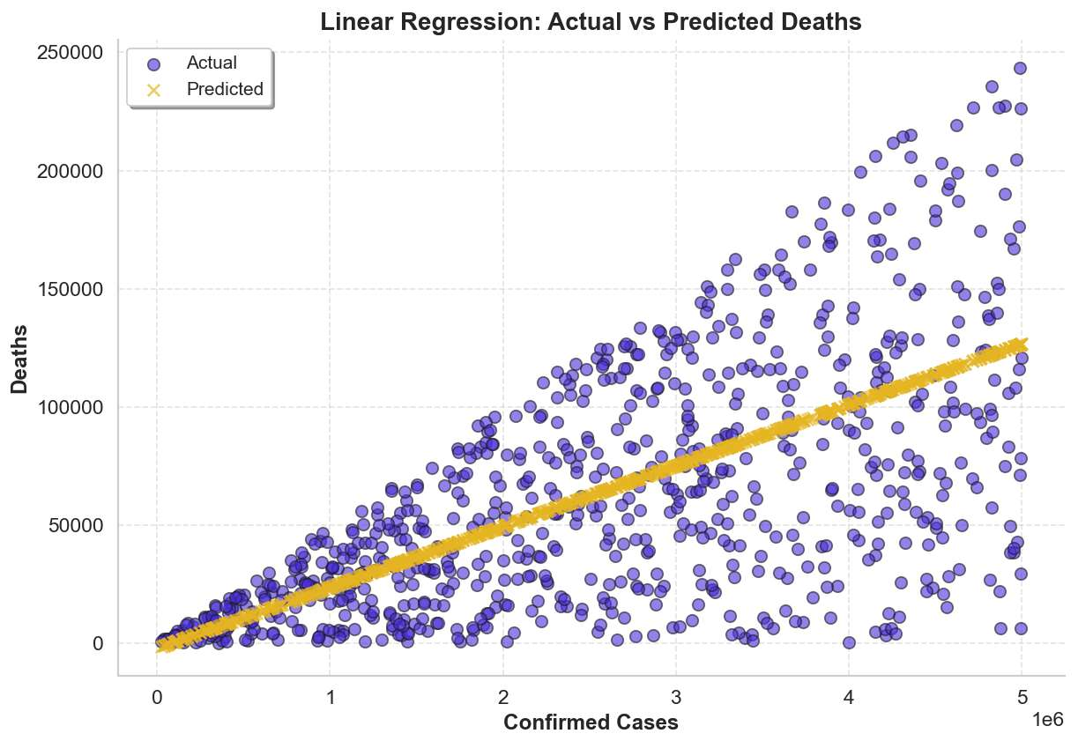
PREDICTING DEATHS FROM CONFIRMED CASES
Model : Linear Regression — Used for
Predicting a linear relationship between variables.
Input :Confirmed Cases — Daily Count of Confirmed Infections Worldwide.
Target Output : Predicted Deaths — Estimated
based on input trends.
Model Results :
Intercept : -1,910.20
Coefficient : 0.0257
Model Performance :
R² Score : 0.398 — Strong accuracy.
Mean Squared Error (MSE) : 1.65 Billion
Mean Absolute Error (MAE) : 30,533
Visualization : Scatter plot — Shows predicted vs. actual deaths.
8

Slide 9
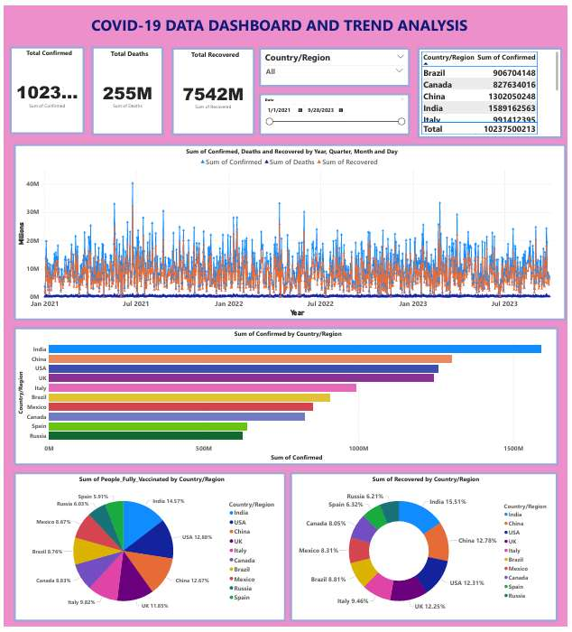
DATA VISUALIZATION AND DASHBOARD ( POWER BI )

Slide 10
KEY INSIGHTS
In 2025, many countries are again reporting a rise in COVID-19 cases, especially during seasonal changes (like winter or monsoon) when people gather indoors and viruses spread more easily.
Recent COVID-19 variants may not cause the same severe symptoms as in early 2020, especially in vaccinated people. However, symptoms can include:
Sore throat, Fatigue or tiredness, Low-grade fever, Headache, In some cases, shortness of breath or chest pain
Some people might think it's just a common cold, which is why testing is important if you're feeling unwell.
COVID-19 spreads mainly through:
Airborne droplets: When someone talks, sneezes, or coughs, the virus travels in tiny droplets.
Close contact: Being near an infected person increases your risk.
Surfaces: While not as common, touching infected surfaces and then touching your face (especially mouth, nose, or eyes) can also spread the virus.
RISK :
Older adults (especially over 60)
People with weak immune systems (e.g., cancer patients)
People with conditions like diabetes, heart disease, or asthma
Even though many people recover easily now, high-risk individuals can still get very sick if infected.
To protect yourself and others :
Wear a mask in crowded or poorly ventilated areas
Wash your hands often or use sanitizer.
Avoid close contact with people who are sick.
Stay updated with vaccines and booster doses
Stay home if you feel sick to prevent spreading it to others.
Importance of Vaccines
Vaccines train your immune system to fight the virus effectively. Even if you catch COVID after vaccination, it is usually less severe. Boosters help your body stay protected, especially as new variants emerge.
10

Slide 11
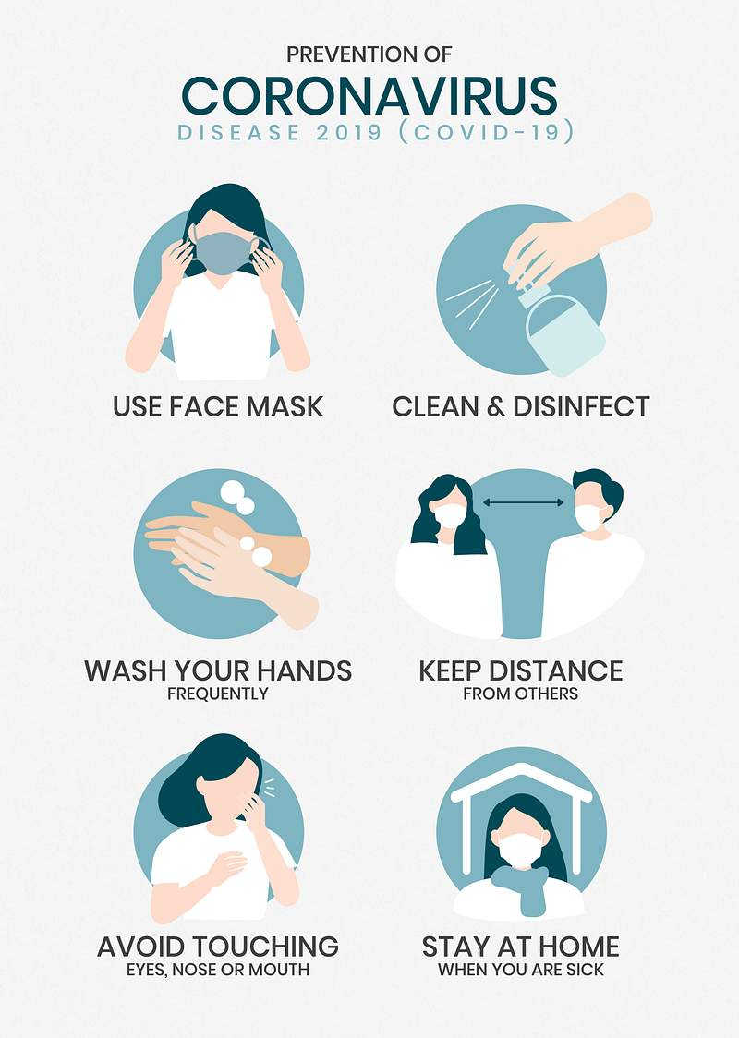
THANK YOU
11

